Slide 1
CHM 5681
Raman spectroscopy
Detector
hν
Source
hν
hν
Sample

Slide 2
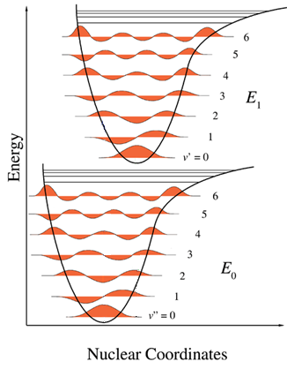
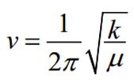
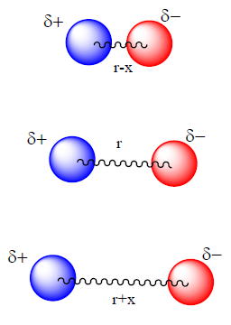
Spectroscopy
Vibration Frequency (ν)
Related to:
Stiffness of the bond (k).
Atomic masses (reduced mass, μ).
Visible: 300-700 nm / 30,000-14,000 cm⁻¹
Mid-IR: 2,500-15,000 nm / 4,000-650 cm⁻¹

Slide 3
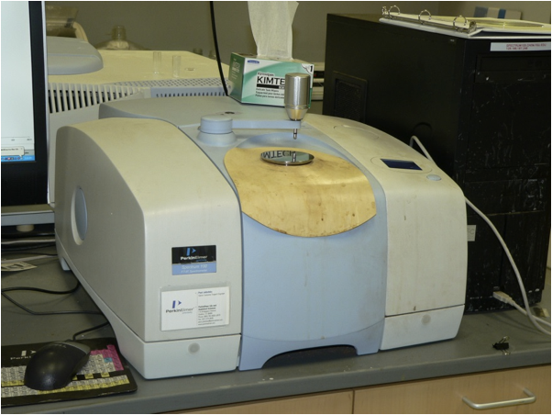
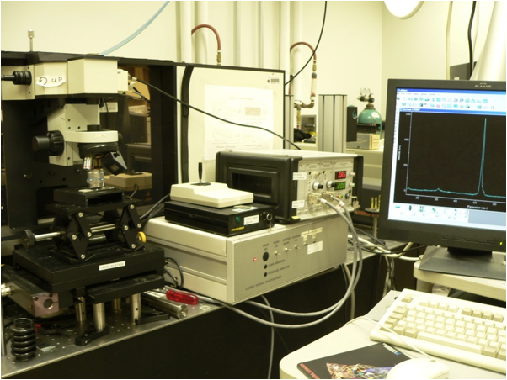
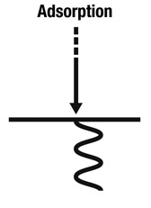
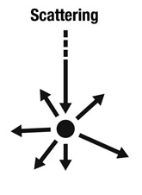
Vibrational Spectroscopy
Infrared Spectroscopy
Raman Spectroscopy

Slide 4
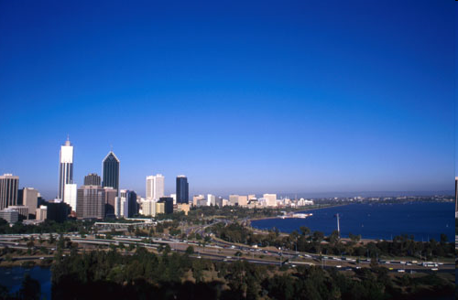
Why is the Sky blue?

Slide 5
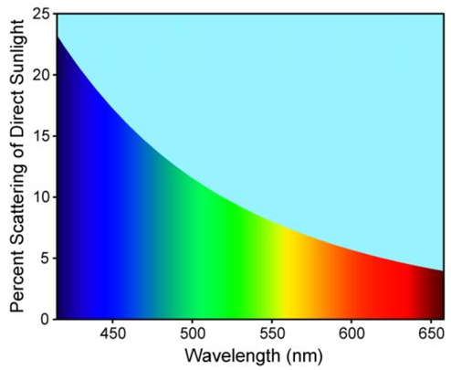
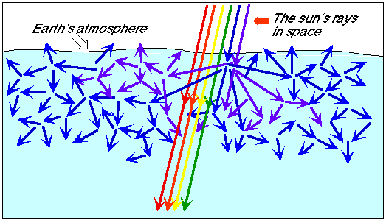
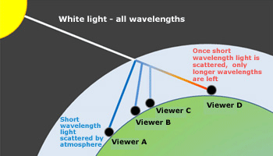
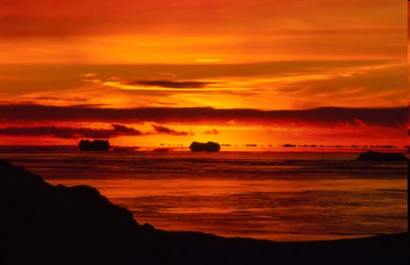
Wavelength Dependent Scatter

Slide 6
Wavelength Dependent Scatter
Scattering depends on:
the size of the scattering particles (R)
the wavelength of light (λ)
Geometric scattering (reflection): R>>λ
Rain drops (R~10-100 μm)
All wavelengths equally scattered
Optical effects: white clouds
Mie scattering: R~λ
Aerosols (R~0.01-1 μm)
Red scattered better than blue
Blue moon, blue sun
Rayleigh scattering: R<<λ
Molecules (R~0.0001-0.001 mm)
Blues scattered better than red
Blue sky, blue mountains, red sunsets
λ
R
λ
R
λ
R

Slide 7
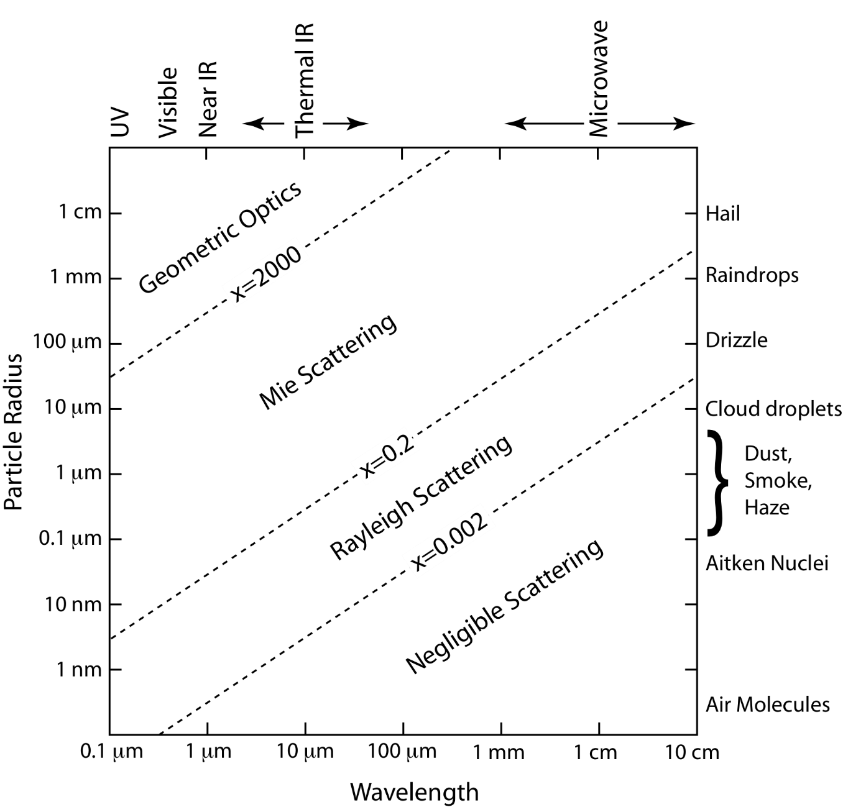
Light Scattering Regime
This plot considers only single scattering by spheres.

Slide 8
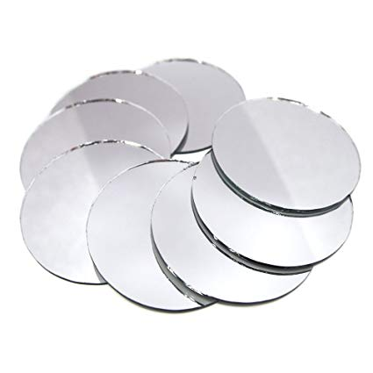

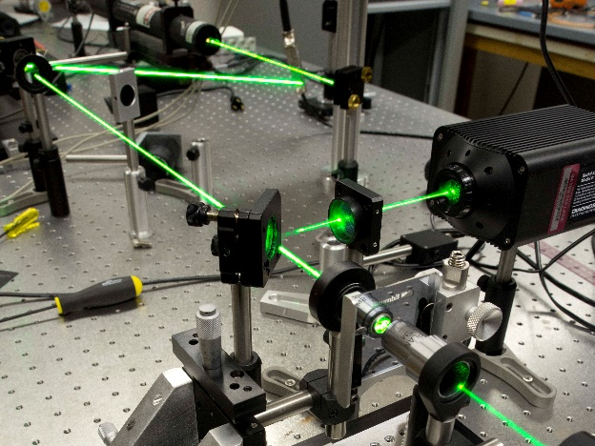
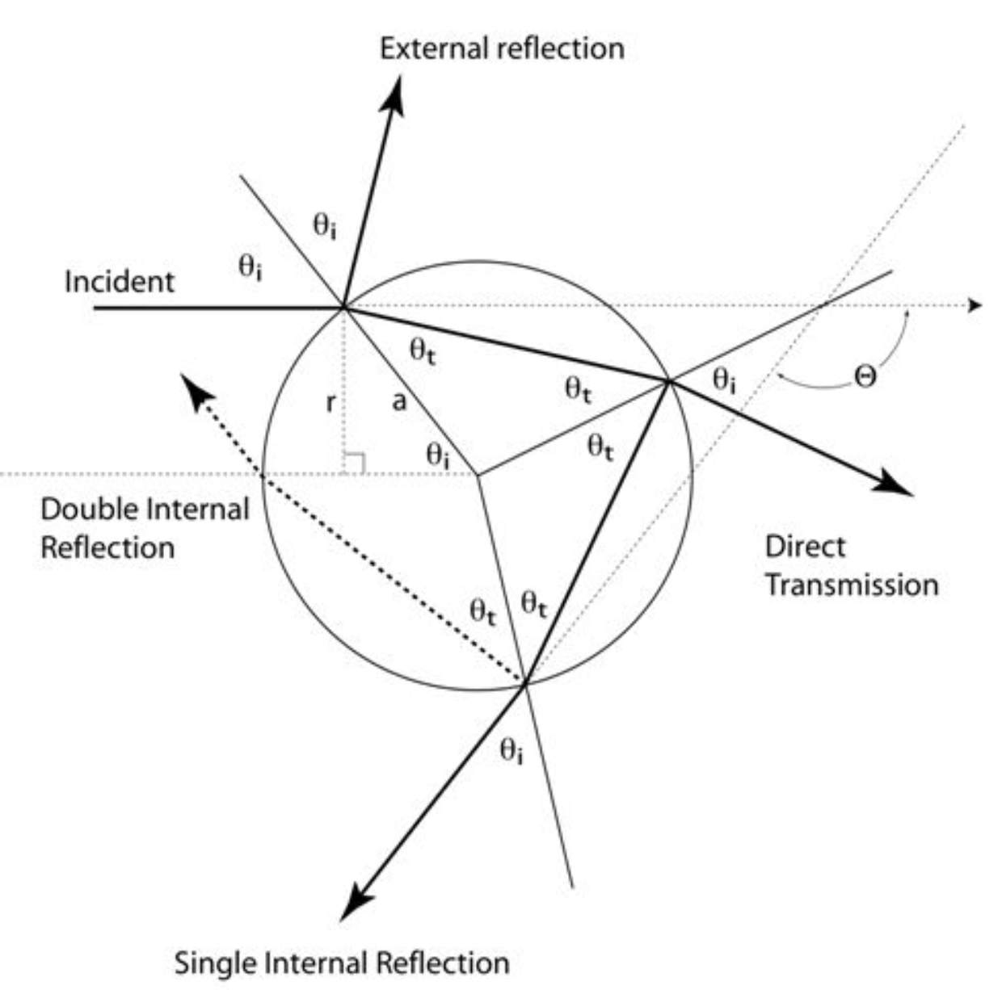
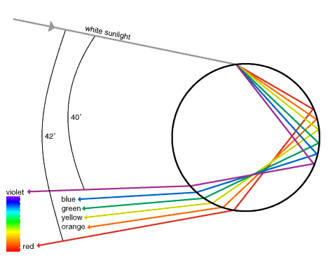
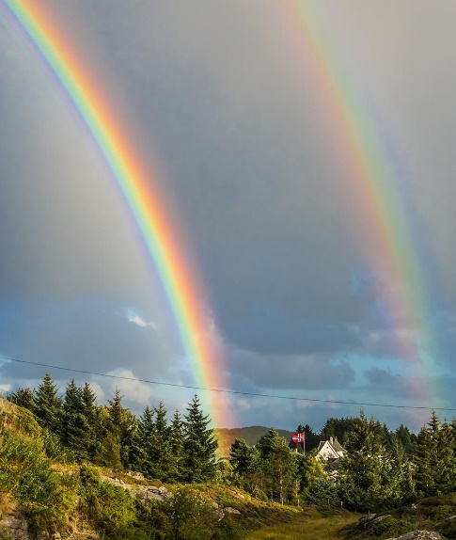
Geometric scattering (reflection): R>>λ

Slide 9
Light Scattering Regime
This plot considers only single scattering by spheres.

Slide 10
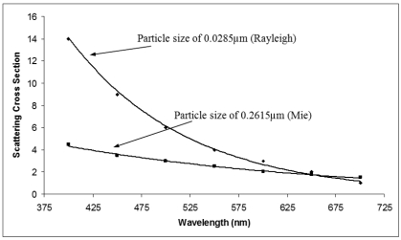
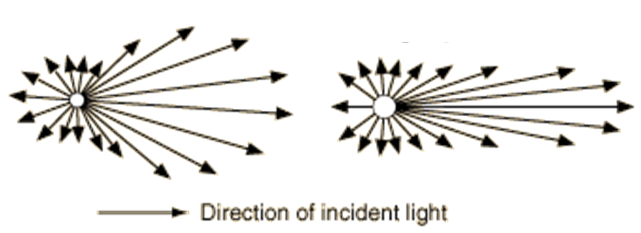
Mie Scattering
Mie scattering: R~λ
Aerosols (R~0.01-1 μm)
Red scattered better than blue
Blue moon, blue sun
λ
R
Small Particle
Large Particle
All directions but not isotropic.
Dependent on particle radius and refractive index.
Much more intense than Rayleigh scattering.
Not as strongly wavelength dependent (λ²).
For colloids in solution it is also known as Tyndall Effect.

Slide 11
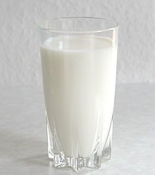

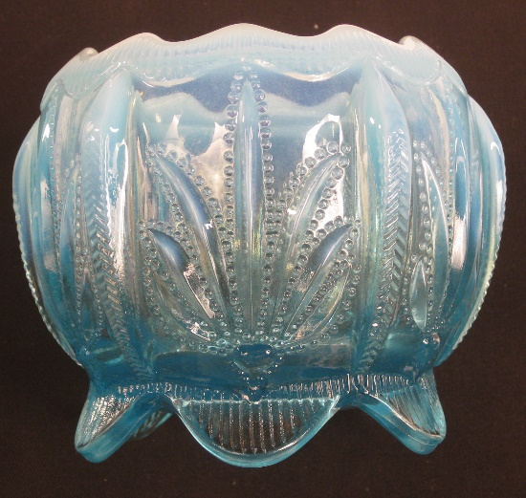
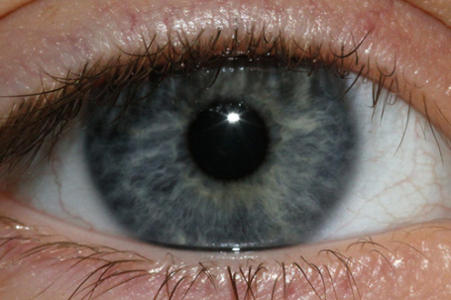
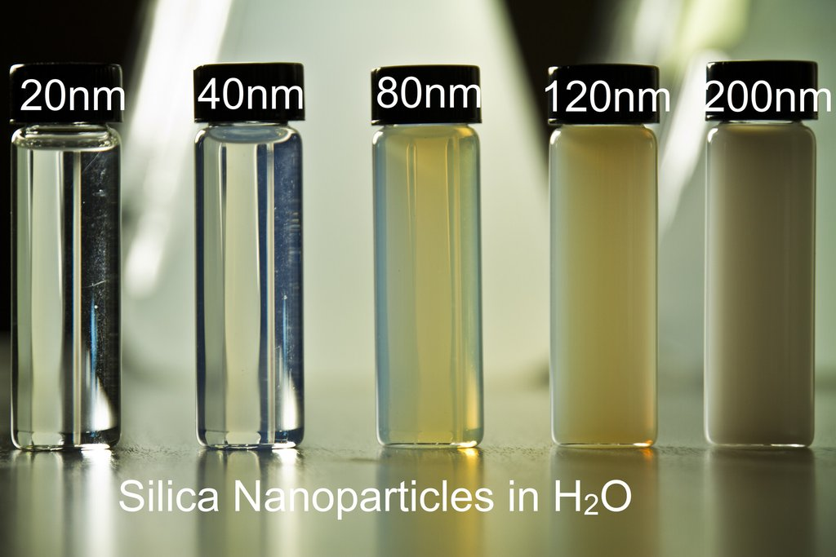
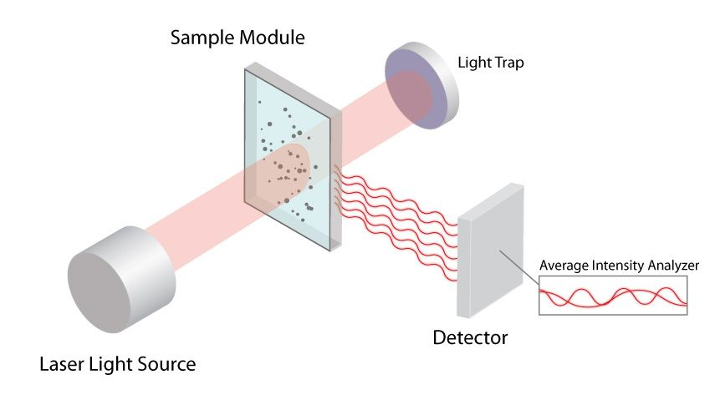
Mie Scattering/Tyndall Effect
Opalescent glass
Dynamic Light Scattering (Mattoussi lab)

Slide 12
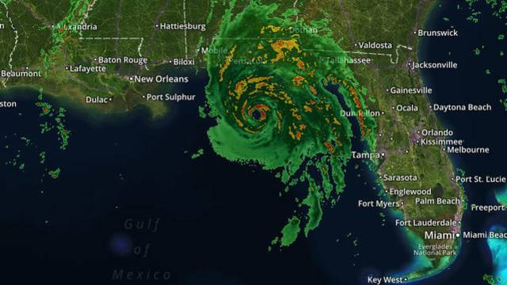

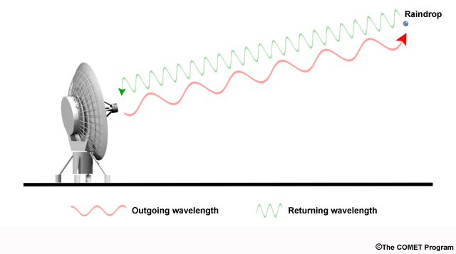
Mie Scattering and Doppler Radar
Hurricane Michael in October 2018
Microwaves

Slide 13
Light Scattering Regime
Atoms
Molecules
Nanoparticles

Slide 14
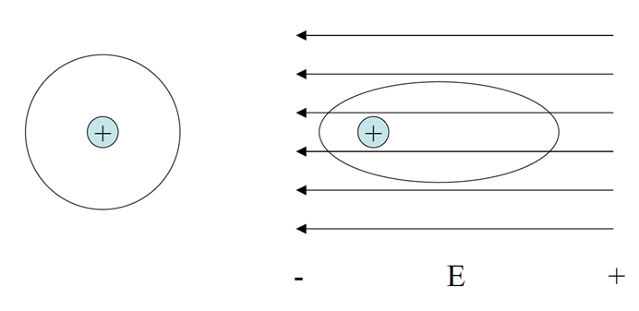
Rayleigh Scattering
Rayleigh scattering: R<<λ
Molecules (R~0.0001-0.001 mm).
What we observe with
Raman spectroscopy.
λ
R
Incident light causes a momentary distortion of the electrons distributed around a bond.
This induces a temporary dipole moment.
The distorted cloud relaxes back to its original state.
A photon is “re-emitted” during relaxation.
The “emitted” photon is usually the same energy as the incident photon.

Slide 15
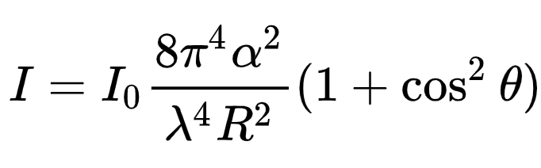
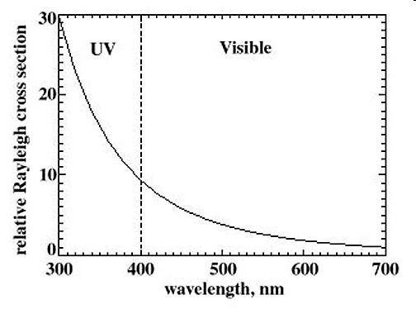
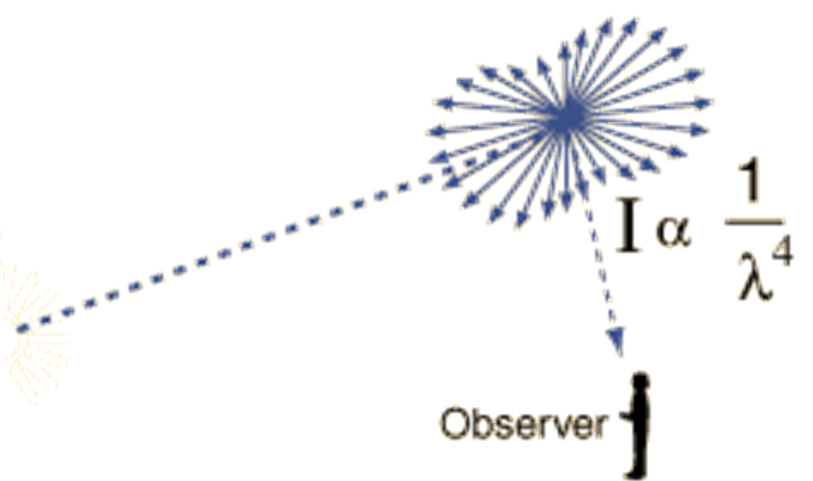
Rayleigh Scattering
I = scattering intensity at θ
I₀ = incident light intensity
θ = angle between incident and scattered light
α = polarizability
λ = wavelength
R = distance from the scatterer
Take homes:
Dependent on α²
Dependent on λ⁴
400 nm scatters ~10 times as much as 700 nm
Source

Slide 16

Rayleigh Scattering
Only ~1 in 10⁶ of the incident photons scatter.
Atmospheric composition: N₂ (78%), O₂ (21%), Ar (1%)
Size of N₂ molecule: 0.31 nm
Size of O₂ molecule: 0.29 nm
Size of Ar molecule: 0.3 nm
400 nm scatters ~10 times as much as 700 nm
Source

Slide 17
Rayleigh Scattering
I = scattering intensity at θ
I₀ = incident light intensity
θ = angle between incident and scattered light
α = polarizability
λ = wavelength
R = distance from the scatterer
Take homes:
Dependent on α²
Dependent on λ⁴
α = polarizability
“Softness” of wave function.
Larger clouds more easily polarized by an electric field.
More polarizable, the greater the induced dipole and scatter.
Polarization of a bond is symmetry dependent.
Raman spectroscopy is symmetry dependent.

Slide 18
Vibrations and Group Theory
1) Find number/symmetry of vibrational modes.
2) Assign the symmetry of known vibrations.
3) Find if a vibrational mode is IR or Raman Active.

Slide 19
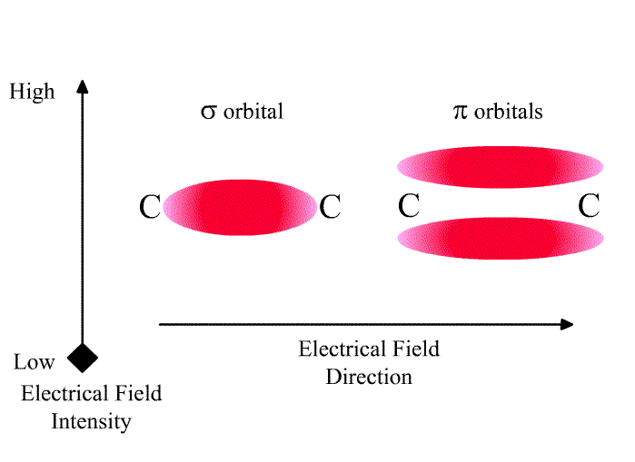

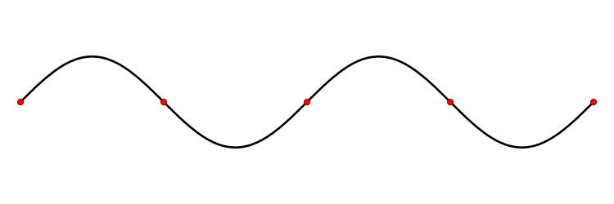
Selection Rules
IR Active
Raman Active
Change in dipole moment.
Change of the polarization.
Deformation of an electron cloud.
If the symmetry label of a normal mode corresponds to x, y, or z, then the fundamental transition for this normal mode will be IR active.
If the symmetry label of a normal mode corresponds to products of x, y, or z (such as x² or yz) then the fundamental transition for this normal mode will be Raman active.
Polarizability has the same symmetry properties as the quadratic functions!

Slide 20
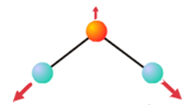
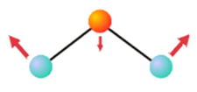
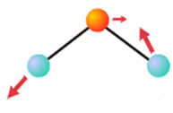
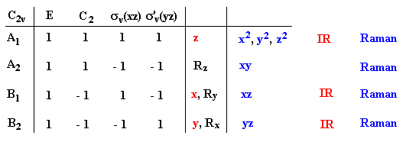
IR vs Raman Active
Stretch
Stretch
Bend
A₁
Vibrations = A₁ + B₂
If the symmetry label of a normal mode corresponds to x, y, or z, then the fundamental transition for this normal mode will be IR active.
If the symmetry label of a normal mode corresponds to products of x, y, or z (such as x² or yz) then the fundamental transition for this normal mode will be Raman active.
A₁ and B₂ are Raman Active.

Slide 21
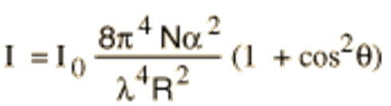
Rayleigh Scattering
I = scattering intensity at θ
I₀ = incident light intensity
θ = angle between incident and scattered light
N = number of scatterers
α = polarizability
λ = wavelength
R = distance from the scatterer
Take homes:
Dependent on α²
Dependent on λ⁴
If Raman active it will inelastically scatter incident light.
Elastic Scattering
Inelastic Scattering
hν
hν
hν
hν
Sample
Sample
Incident and scattered light the same energy.
Most scatter is elastic.
Incident and scattered light NOT the same energy.
Much more rare.

Slide 22
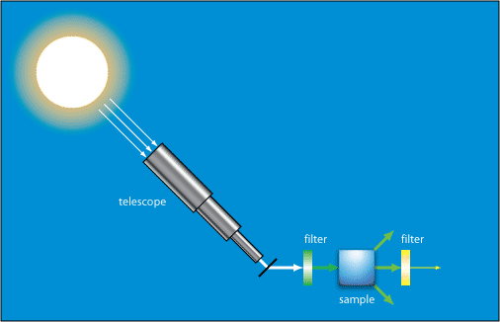
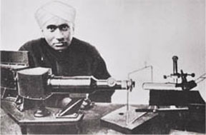
Inelastic Scattering
1871 – Rayleigh elastic scattering described
1923 – Inelastic light scattering is predicted by A. Smekel
1928 – C.V. Raman and K.S. Krishnan see “feeble fluorescence” from neat solvents

Slide 23
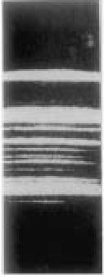
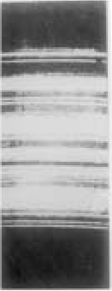
Inelastic Scattering
1871 – Rayleigh elastic scattering described
1923 – Inelastic light scattering is predicted by A. Smekel
1928 – C.V. Raman and K.S. Krishnan see “feeble fluorescence” from neat solvents
Spectrum on photographic plate.
Hg arc lamp
Shift not dependent on incident wavelength.
Shift dependent on structure of molecules.
Gas, solids, and liquids.
Hg arc lamp
through benzene
New “emission” lines.

Slide 24
Raman Spectroscopy
Inelastic Scattering
1871 – Rayleigh elastic scattering described
1923 – Inelastic light scattering is predicted by A. Smekel
1928 – C.V. Raman and K.S. Krishnan see “feeble fluorescence” from neat solvents
1928 – Landsberg and Mandelstam see unexpected frequency shifts in scattering from quartz
1930 – C.V. Raman wins Nobel Prize in Physics
1957 – First confocal Raman spectrometer
1961 – Invention of laser makes Raman experiments easier
1976 – Time-resolved Raman
1977 – Surface-enhanced Raman scattering (SERS) is discovered
1997 – Single molecule SERS is possible

Slide 25
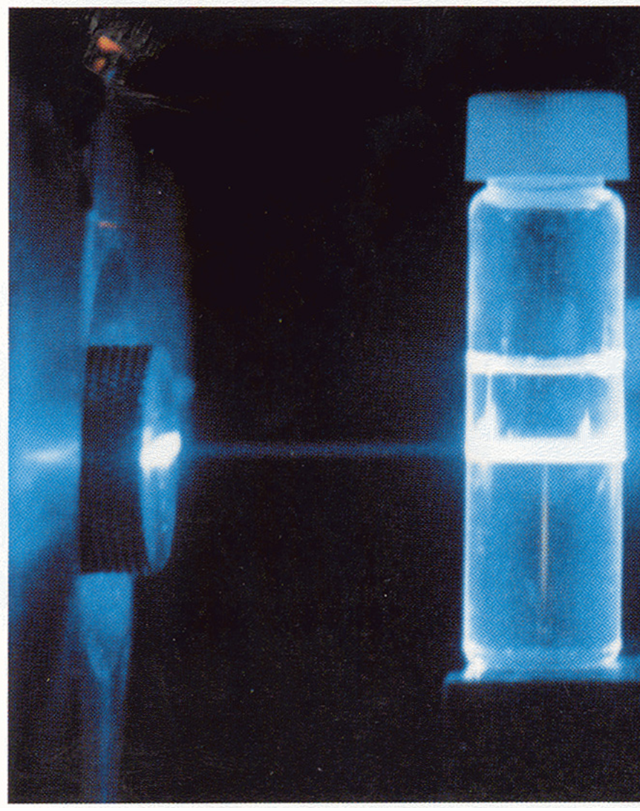
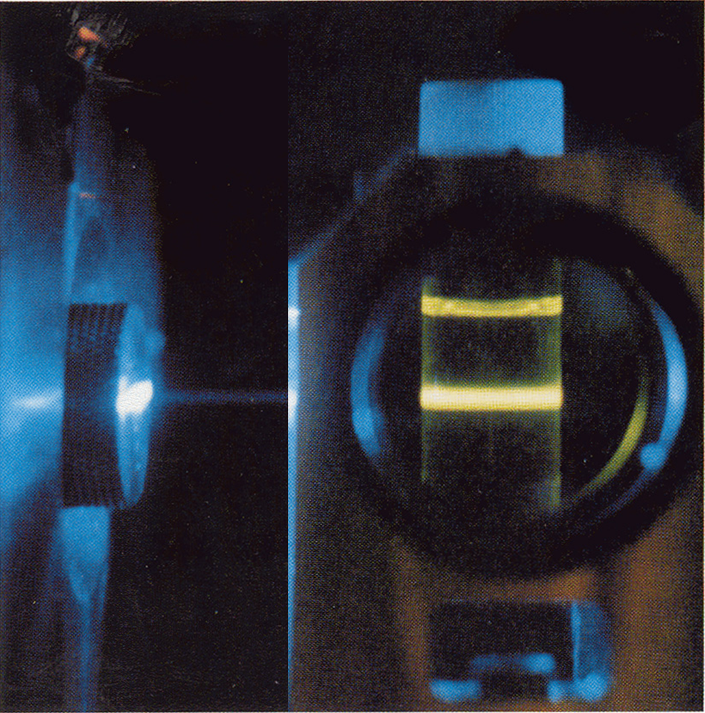
Cyclohexane Scattering
488 nm laser
488 nm laser + notch filter
Elastic Scattering
Inelastic Scattering

Slide 26
Raman Scattering
Raman
Stokes shift
Rayleigh
Elastic
Raman
anti-Stokes shift
S₁
S₁
S₁
Virtual state
Energy
Energy
Energy
ν₂
ν₂
ν₂
S₀
ν₁
S₀
ν₁
S₀
ν₁
ν₀
ν₀
ν₀
ν_{ex} > ν_{scatter}
ν_{ex} = ν_{scatter}
ν_{ex} < ν_{scatter}
Δν = ν_{ex} - ν_{scatter}
= ν_{vib}

Slide 27
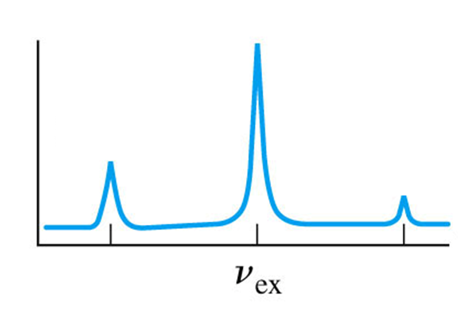
Raman Spectra
Stokes
Rayleigh
anti-Stokes
Virtual state
Energy
Energy
Energy
ν₂
ν₂
ν₂
S₀
ν₁
S₀
ν₁
S₀
ν₁
ν₀
ν₀
ν₀
Rayleigh
Stokes
anti-Stokes
Intensity (counts)
Energy (cm⁻¹)

Slide 28
Raman Spectra
Stokes
Rayleigh
anti-Stokes
ΔE = ν_{vib}
10⁷ counts
Intensity (counts)
1 count
ν_{ex} - ν_{vib}
ν_{ex} + ν_{vib}

Slide 29
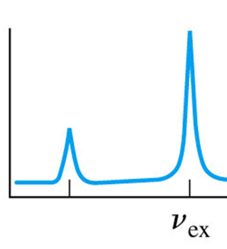
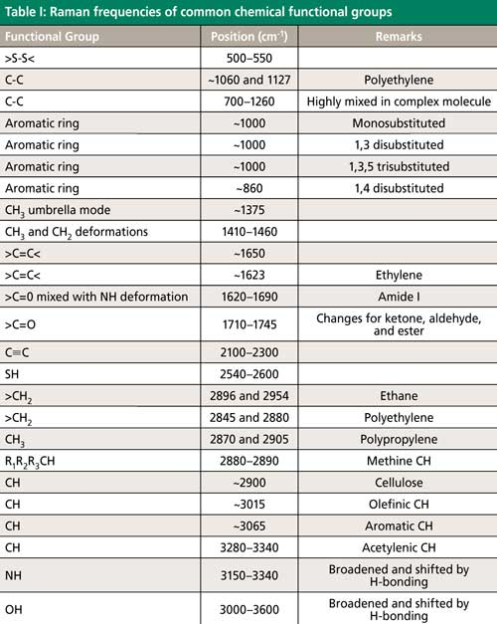
Raman Spectra
ν_{vib}
Intensity (counts)
ν_{ex} - ν_{vib}
Energy
ν_{vib}
S₀

Slide 30
Wavelength Independent
Near IR
785 nm
S₁
Visible
514 nm
Energy
785 nm
514 nm
Intensity
ν₂
S₀
ν₁
ν₀
Stokes
Anti-Stokes
Stokes
Anti-Stokes
–∆Ε
+∆Ε
–∆Ε
+∆Ε
11,000
13,000
15,000
17,000
19,000
21,000
Excitation Energy, σ (cm^{–1})

Slide 31
Intensity of Raman Peaks
<0.01% of incident photons scatter elastically.
<0.00000001% scatter inelastically.
Intensity/ratio dependent on:
Intensity of the source
Concentration of the molecule
Polarizability of the molecule
Excitation wavelength
Dependent on λ⁴
Higher energy = decomposition
10⁷ counts
1 count
Intensity (counts)
ν_{ex} - ν_{vib}

Slide 32
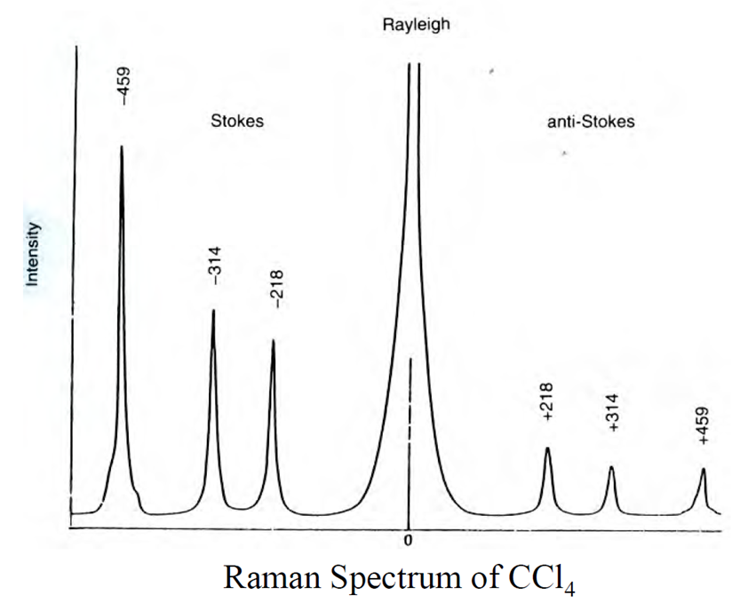
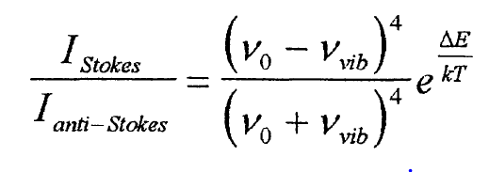
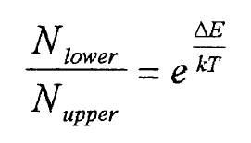
Intensity of Stokes vs Anti-stokes
Stokes and anti-Stokes shift are the same.
I_{stokes} is “always” greater than I_{anti-Stokes}
Stokes
anti-Stokes
Energy
ν₂
ν₂
S₀
ν₁
S₀
ν₁
ν₀
ν₀
Excitation probabilities are similar.
Concentration of ν₀ > ν₁.
Follows Boltzmann distribution.
Increasing temp
increases I_{anti-Stokes}
decreases I_{stokes}
N_{lower} > N_{upper}
ν₀ > ν₁

Slide 33


Increasing Signal Intensity
Non-Resonant
Resonant
Tacoma Narrows Bridge (1940)

Slide 34
Increasing Signal Intensity
Non-Resonant
Resonant
S₁
S₁
Virtual state
Not absorption and emission!
Energy
Energy
ν₂
ν₂
S₀
ν₁
S₀
ν₁
ν₀
ν₀
Δν is the same.
<0.00000001% of incident photons
Resonant transition = more polarizable
Intensity increase by:
x10 for MC/d-d transition
to
x100,000 for π-π* transition

Slide 35



Problem with Resonance Raman
Abs
Fluorescence
Stokes Raman Scatter
λ_{ex}
Raman + Fluorescence
<0.01%
<0.001%
100-0%
<0.0000001%
Stokes
Raman
Spectrum
λ_{ex}

Slide 36
Avoiding Fluorescence
Use non-resonant Raman
-Sub-Band Gap light
-Red or nearIR laser
Temporal Gating
-Raman is fast (<ps)
-Emission is “slow” (> ps)
Anti-stokes Raman Spectroscopy
-Emission is “always” stokes
Polarization
-Emission if usually isotropic
-Scattering is polarized
Raman + Fluorescence
Stokes Raman Spectrum
λ_{ex}

Slide 37


Raman Spectrometer
Detector
hν
Source
hν
hν
Sample
Procedure
Step 1: Prepare a sample
Step 2: ???
Step 3: Obtain spectra (Profit!)

Slide 38

Raman Spectrometer
Detector
Source
1) Light source
2) Sample
3) Wavelength Selector
4) Detector
5) Filters, Slits, Polarizers

Slide 39


Sources
Ideal
-Narrow bandwidth
-High intensity
Theoretically could be any light source + monochrometer or filter.
Almost always a laser
Detector
hν
Source
hν
hν
Sample
Argon Ion Laser
Wavelength (nm)

Slide 40


Sources

Slide 41




Detectors
Detector
high sensitivity
high signal/noise
constant response for λs
hν
electrical signal
Unusually the same as UV-Vis/Fluorescence Spectroscopy
Single λ detection
Full spectra detection
Diode
PMT
CCD
Diode Array

Slide 42



Gas or Liquid Samples
Cuvette
Vial
NMR Tube
Transparent to visible and near IR light.
Raman inactive: quartz, glass, some plastics.
Test sample holder and solvent for Raman peaks.
Unlike transmission IR, can be used with water.
-Water = weak Raman scatterer
-Biologically relevant structures

Slide 43








Solid Samples
Neat Solids
Thin Films
Little to no sample prep.
Tissue
Capillary Tube
Antiquities
Sample size ≈ laser spot size

Slide 44
Raman Spectrometer
Detector
Source
1) Light source
2) Sample
3) Wavelength Selector
4) Detector
5) Filters, Slits, Polarizers

Slide 45



Wavelength Selector: Filters
Narrow Bandpass Filter
Notch Filter

Slide 46


Wavelength Selector
Grating
Dispersive Spectrometer (visible)
Interferometer
FT Spectrometer (nearIR-IR)

Slide 47

Wavelength Selector: Grating
Dispersive Spectrometer (visible)

Slide 48

Wavelength Selector: Interferometer
FT Spectrometer (nearIR-IR)

Slide 49


FT-Raman vs. Dispersive Raman
Advantages of FT
NIR lasers reduce fluorescence.
Relatively inexpensive.
High resolution.
Collects Stokes and Anti-stokes simultaneously.
Can be directly coupled to an FT-IR spectrometer.
Disadvantages of FT
Sample heating + blackbody emission.
Lower scattering (λ⁴).
NIR absorption bands.
Slow (tens of minutes).

Slide 50
Raman Spectrometer
Detector
hν
Source
hν
hν
Sample
Raman Measurements
Microscope
Polarized
Confocal
SERS
Time Resolved
Portable

Slide 51

Raman Microscope

Slide 52
Raman Microscope
Optical fiber
Mono-
chromator
CCD
Focusing lens
Edge filter
Camera
Computer
Dichroic
Mirror
LASER
Objective lens
Stage

Slide 53

Raman Instrumentation
Raman Microscope
Narrow peaks.
Need higher resolution.
Tunable Laser System
Versatile Detection System

Slide 54


Raman Microscope

Slide 55



Raman Microscope Map

Slide 56
In House Raman Spectrometer
Horiba JY LabRam HR800 Raman Spectrometer
Excitation:
785 nm, 633 nm, 514.5 nm,
488 nm, 458 nm & 364 nm
5x, 10x, 20x, 40x & 50x Visible/NIR objectives
CCD detector
MAC Lab
(Materials Characterization)
CSL 3701

Slide 57

Raman Spectrometer
Detector
hν
Source
hν
hν
Sample
Raman Measurements
Microscope
Polarized
Confocal
SERS
Time Resolved
Portable

Slide 58



Polarized Raman Spectroscopy

Slide 59
Raman Spectrometer
Detector
hν
Source
hν
hν
Sample
Raman Measurements
Microscope
Polarized
Confocal
SERS
Time Resolved
Portable

Slide 60



Raman Microscopy
Conventional
Confocal

Slide 61

Raman Microscopy

Slide 62

Confocal Raman

Slide 63

Confocal Raman
Depth Profiling
x
Polyethylene
nylon
75 μm
Polyethylene
z

Slide 64
Confocal Raman
Depth Profiling
500
1000
1500
2000
film
adhesive
Glass
500
1000
1500
2000

Slide 65


Confocal Aperture and Field Depth
Confocal Raman
3D Imaging

Slide 66
Raman Spectrometer
Detector
hν
Source
hν
hν
Sample
Raman Measurements
Microscope
Polarized
Confocal
SERS
Time Resolved
Portable

Slide 67



Surface Enhanced Raman Scattering (SERS)
M. Fleischmann, P. J. Hendra, and A. J. McQuillan. Raman spectra of pyridine adsorbed at a silver electrode. Chem. Phys. Lett., 1974, 26, 163.
surface
solution

Slide 68

Surface Enhanced Raman Scattering (SERS)
Samples adsorbed on the surface of colloidal metal particles (usually silver, gold, or copper)
Enhancement of the electromagnetic field surrounding molecule near plasmon resonance.
Large local field increases the absorption cross section.
Scattered radiation is also enhanced.
Signal increase by a factor of 10⁶ to 10⁸.

Slide 69

Surface Enhanced Raman Scattering (SERS)
E. C. Le Ru et al., J. Phys. Chem. C, 2007, 111, 13794

Slide 70



Surface Enhanced Raman Scattering (SERS)
Substrate

Slide 71
Raman Spectrometer
Detector
hν
Source
hν
hν
Sample
Raman Measurements
Microscope
Polarized
Confocal
SERS
Time Resolved
Portable

Slide 72
Transient Absorption Spectroscopy
A
C
A
C*
A⁻
C⁺

Slide 73



Time-Resolved Raman
A
C
A
C*
A⁻
C⁺

Slide 74

Time-Resolved Raman
Ground State Raman
Excited State Raman
Virtual state
S₁
Virtual state
Energy
ν₂
S₀
ν₁
ν₀

Slide 75
Time-Resolved Raman
(1)
Detector
(3)
Events:
1) Raman Spectrum
2) Excitation Flash
3) Raman Spectra
(1)
(3)
Source
(2)
hν
hν
hν
Sample
Detector
Excited Processes
Raman probe
pump
probe
probe
probe
Time

Slide 76

Difference Spectra
S₁
4 excited states/100 molecules
E
hν
S₀
I for xS₀ molecules
I for (x - y)S₀ + yS₁ molecules

Slide 77

Difference Spectra
I(t) - I(0) = ΔI
I(0) = intensity without laser pulse
I(t) = intensity at time t after laser pulse
I(t)
I(0)
ΔI at time t
-
=
I for
(x - y)S₀ + yS₁
I for
xS₀
- yS₀ + yS₁

Slide 78

Time-Resolved Raman (10⁻⁹ s)
OPO: Optical Parametric Oscillator, RS: Raman Shifter, DG: Delay Generator, PB: Pellin-Broca Prism, DM: Dichroic Mirror, PD: Photodiode, L1: Focusing Lens, L2: Collection Optics, NF: Notch Filter (required for single monochromator), MONO: Double Monochromator (single and triple monochromator can also be used), CCD: Charge Coupled Device, ICCD: Intensified CCD, EMCCD: Electron Multiplying CCD, PDA: Photodiode Array, OSC: Oscilloscope, CP: Circulating Pump, and PC: Personal Computer

Slide 79

Time-Resolved Raman (10⁻¹² s)

Slide 80

Time-Resolved Raman
J. Chem. Phys. 2001, 115, 11228.

Slide 81
Raman Spectrometer
Detector
hν
Source
hν
hν
Sample
Raman Measurements
Microscope
Polarized
Confocal
SERS
Time Resolved
Portable

Slide 82




Portable Raman Spectrometer

Slide 83
Raman Spectrometer
Detector
hν
Source
hν
hν
Sample
Raman Measurements
Microscope
Polarized
Confocal
SERS
Time Resolved
Portable

Slide 84
Applications
Identification of inorganic, organic, and biological samples
Identification of components of an unknown mixture
Fingerprint spectra
Identification of crystalline phases and orientations
Measure stress on solids
Analysis of solids, liquids, and gasses
Component quantification
Forensic sciences
In measurement and analysis of Atmospheric Spectra

Slide 85


Mechanical Strain
Nasdala, L., Harris, J.W. & Hofmeister, W. (2007): Micro-spectroscopy of diamond. Asia Oceania Geosciences Society, 4th Annual Meeting, Bangkok, Thailand, August, 2007.
Nasdala, L., Raman barometry of mineral inclusions in diamond crystals. Mitt. Österr. Miner. Ges. 149 (2004)

Slide 86
Amorphous vs Crystalline
Zircon (ZrSiO₄): amorphous (blue) and crystalline (red).

Slide 87


Polymorph Determination
Anatase and Rutile TiO₂ –
identical chemical composition, different crystalline structures.
Rutile
Anatase

Slide 88


Composition
plastic

Slide 89


Ivory or Plastic?
Composition
1725 cm⁻¹ = pmma
1086 cm⁻¹ = calcite

Slide 90



Composition
“15th century” map
1920s
Brown, K. L.; Clark, J. H. R., Anal. Chem. 2002, 74,3658.

Slide 91
Tissue Identification

Slide 92


Tissue Identification
In contrast to fluorescent imaging, it does not require an emissive molecule/label.

Slide 93
Vibrational Spectroscopy
Infrared Spectroscopy
Raman Spectroscopy
vs.

Slide 94
Comparing Vibrational Spectroscopies
Advantages of Raman Over IR
Can use visible light sources and detectors.
Glass and quartz sample holders can be used.
Symmetric vibrations can be observed (crystalline solids)
Raman intensities proportional to laser power.
Minimal sample prep.
Raman bands are polarized (orientation information).
Confocal for spatial imaging.
Readily observe 100 to 700 cm⁻¹ region (M-L bonds).
Water can be used as a solvent (biological native state).
Disadvantages of Raman vs. IR
Very weak signals (10⁶ photons for 1 Raman photon)
Requires a laser.
More expensive.
More difficult (laser alignment, ambient lighting).

Slide 95


Complementary Techniques

Slide 96

Complementary Techniques

Slide 97
Raman Spectroscopy End
Any Questions?

